Slide 1


Technology & Caregiving
By: Seraphina Francisco, LMSW, CDP
Caregiver Support Program

Slide 2
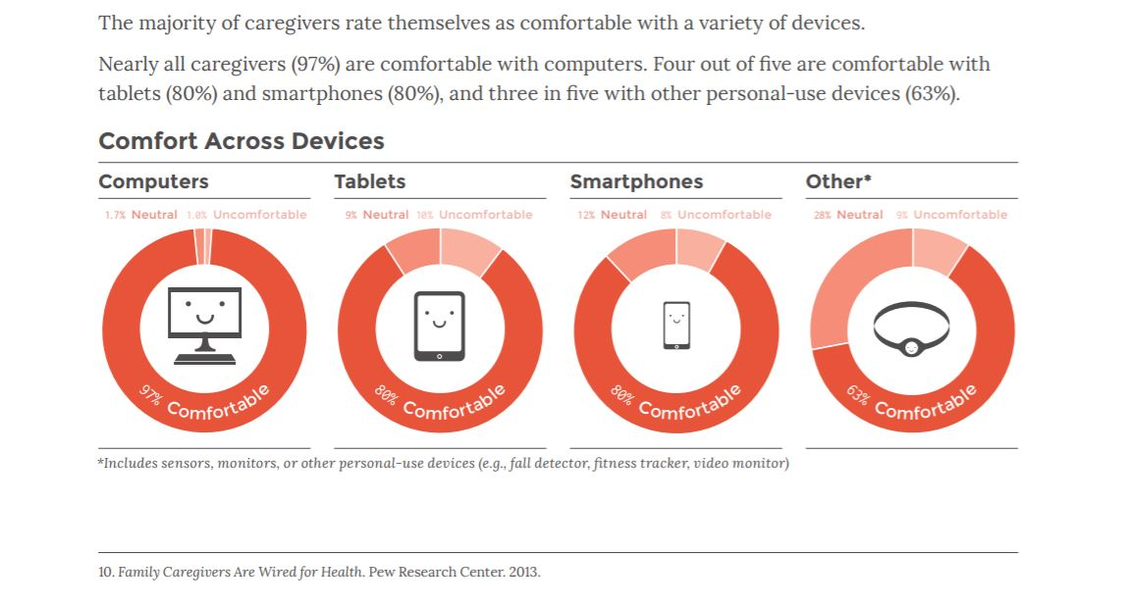
Caregivers with Technology

Slide 3
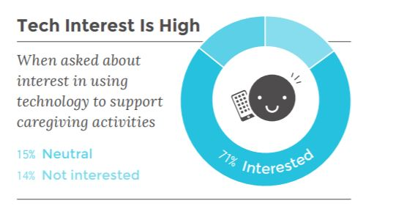
Utilizing Technology to Help

Slide 4
How can I use it?
Organizing your older adult’s information
Managing behaviors or medications
Personal emergency Response Systems
Checking in on older adult
Transportation options
devices for memory care
Self-Care for the Caregiver
Managing Finances

Slide 5
Organization
Important documents
Doctor’s information
Appointments
Medication lists
Examples of Phone Apps:
  CareZone
  Caring Bridge
  Lotsa Helping Hands
  Caring Village

Slide 6
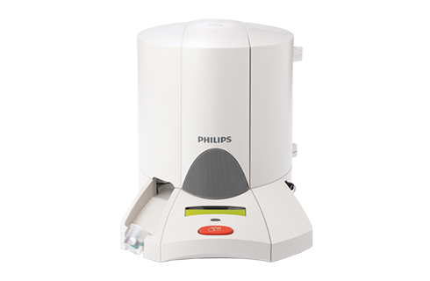
Managing Behaviors or Medications
To track behaviors of your loved one
To track medications taken
To distribute medication
  Examples of Phone Apps:
  Medisafe
  Mymeds

Slide 7
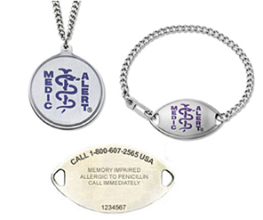
Personal Emergency Response Systems
American RedCross Lifeline
Lifeline Phillips
Jewish Family Service Lifeline
MedicAlert+ Alzheimer's Association

Slide 8

Checking in on Older Adult
Webcams (with permission of older adult)
Motion sensor cameras
Ipad Facetime
Google Duo
Cell phone tracking capabilities on smartphone

Slide 9

Transportation Options
These all have older adults options:
Bubbl
GoGo Grandparent
Envoy America

Slide 10
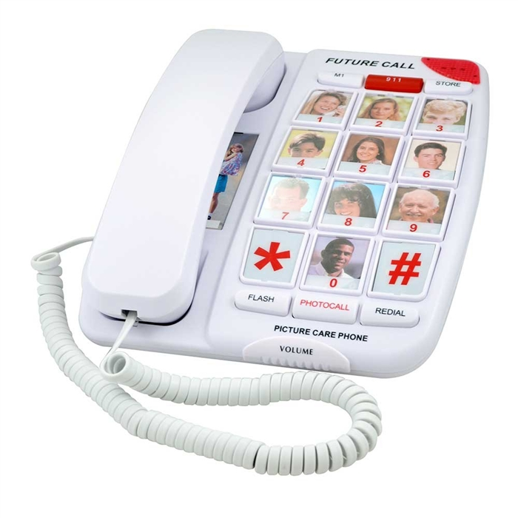
Devices for Memory Care
Door Alarms
Specialized phones
Simplified Clocks, TV, Remotes, and Radios

Slide 11
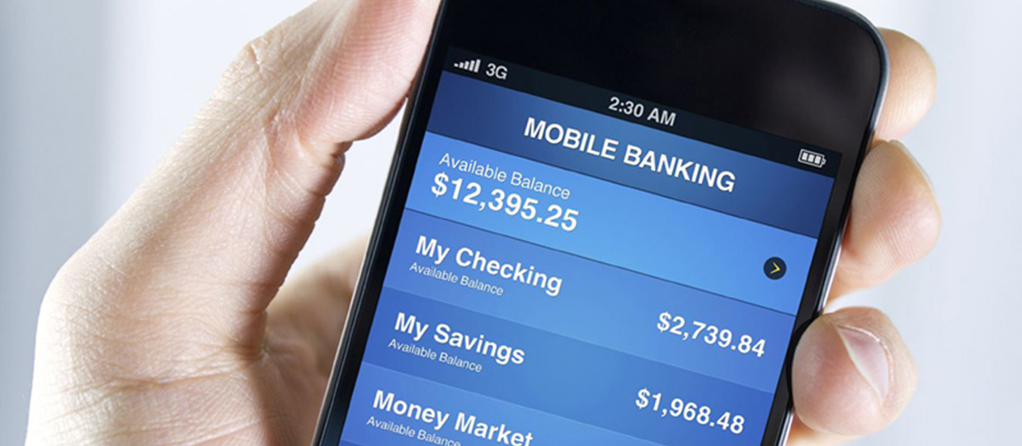
Managing Finances
Getting a bank account with mobile banking or computer capabilities
Access to a loved one’s account legally
Monitoring what is going in and out of account

Slide 12

Self-Care for the Caregiver
Examples of Meditation Apps:
Insight Timer
Calm
UNWIND
Happify
Breathe2Relax
Virtual Hope box

Slide 13

Final Thoughts
Try technology to help your caregiver responsibilities
Not all of it will work for your situation(trial & error)
Check to see if anything is covered through insurance

Slide 14
Sources of information:
https://www.aarp.org/content/dam/aarp/research/surveys_statistics/ltc/2018/caregivers-technology-needs.doi.10.26419-2Fres.00191.002.pdf
https://www.alzstore.com/alzheimers-dementia-wandering-s/1828.htm
https://www.alz.org/help-support/caregiving/safety/medicalert-with-24-7-wandering-support
https://www.aarp.org/content/dam/aarp/research/surveys_statistics/ltc/2018/caregivers-technology-needs.doi.10.26419-2Fres.00191.002.pdf
https://www.alzstore.com/alzheimers-dementia-wandering-s/1828.htm
https://www.alz.org/help-support/caregiving/safety/medicalert-with-24-7-wandering-support

Slide 15
Additional Questions:
Contact me: 214-525-6150
Seraphina Francisco, LMSW, CDP
Caregiver Support Specialist
sfrancisco@theseniorsource.org

