Slide 1


Self-Care for Caregivers
Seraphina Francisco, LMSW CDP
Eldercare Specialist

Slide 2
What is a caregiver?
Definition

Slide 3

Caregiver Health
Providing care for loved ones that are chronically ill can have extreme effects on a persons overall health
It is common that people tend to neglect themselves when caring for others, because of this, caregiver health is steadily become a public health issue

Slide 4
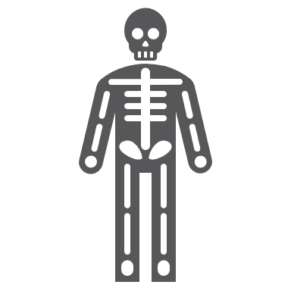



Effects on Caregiver Health
Caregivers suffer from higher levels of depression (40-70%), stress and frustration. Stressful situations may lead to harmful behaviors
They have higher rates of physical ailments like heart disease
For female caregivers specifically: higher levels of depressive and anxiety symptoms and lower levels of subjective well-being, life satisfaction, and physical health
Dramatic increase of mental health consequences among women who provide 36 or more hours per week of care to a spouse.

Slide 5
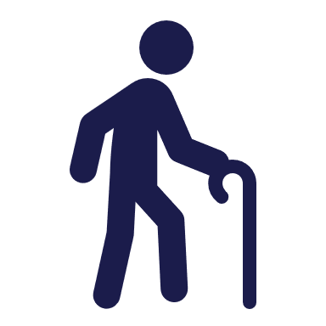

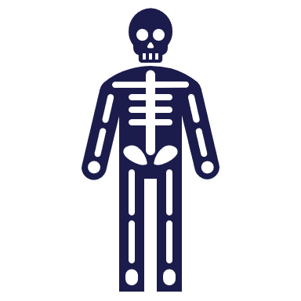

Effects on Caregiver Health
Elderly spousal caregivers (aged 66-96) who experience caregiving-related stress have a 63% higher mortality rate than non-caregivers of the same age.
Spousal caregivers who provide 36 or more hours per week of care are slightly more likely to smoke and consume more saturated fat.
Compared to non-caregivers, women caregivers are twice as likely not to fill a prescription because of the cost (26% vs. 13%).
Caregivers’ self-care suffers because they lack the time and energy to prepare proper meals or to exercise. About six in ten caregivers in a national survey reported that their eating (63%) and exercising (58%) habits are worse than before

Slide 6



What is
Self-care?
Self-care is the practice of taking action to improve one's own health by protecting one’s own well-being and happiness during periods of stress.
It is proven that Caregivers have lower rates of practicing self-care or engage in preventative health behaviors.
An estimated 72% of Caregivers report not going to doctor appointments as often as they should and 55% miss their appointments

Slide 7
How to apply Self-Care:
Take
Caregivers must take care of themselves in order to take care of others. The oxygen mask airplane scenario.
Recognize
Caregivers must recognize their need to care for themselves and engage in holistic activities
Include
Holistic activities can include: anything that has a positive effect mentally, physically and emotionally.

Slide 8
Emotional
Depression
Stress
Burn-out
Frustration-harm of self/recipient
Guilt/shame/embarrassment

Slide 9
Physical
Medication
Medical Appointments
Chronic illness
Fatigue
Unhealthy Habits-eating bad foods/engaging in dangerous behaviors

Slide 10
Social
Isolation
Limit involvement
Pause on career-or giving up career as a whole
Relocation
Family dynamic issues/concerns
Setting boundaries-could be placed with emotional…realistic expectations… lead into more info on self care

Slide 11
Activity
2 minute breathing meditation exercise for Caregivers AARP
https://www.youtube.com/watch?v=CAlWKqZLC4Y

Slide 12
How can the Caregiver Support Program help you?
Provides Information & Resources to help caregivers
Provides Supportive Counseling
Attend our Support Group for Caregivers
Sets up a Care Coordination Meeting with families
Attend our Caregiving with Confidence Seminars

